Slide 1




Basics of R
How does it work and how does it store data?
Dr. Ortis Yankey,
Research Fellow, SSPM Group, WorldPop
Feb 2023

Slide 2
Part 1: Principles of R
Principles of R
Creating Data in R
Data Handling

Slide 3
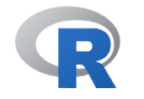
What is R?
R is a programming language originally developed for statistical analysis
R can be extended to do a lot of things:
Statistical analysis
Machine learning, Deep learning
Visualizations
Reporting and documents (Markdown / LaTeX)
Mapping (GIS)
many other things…..

Slide 4
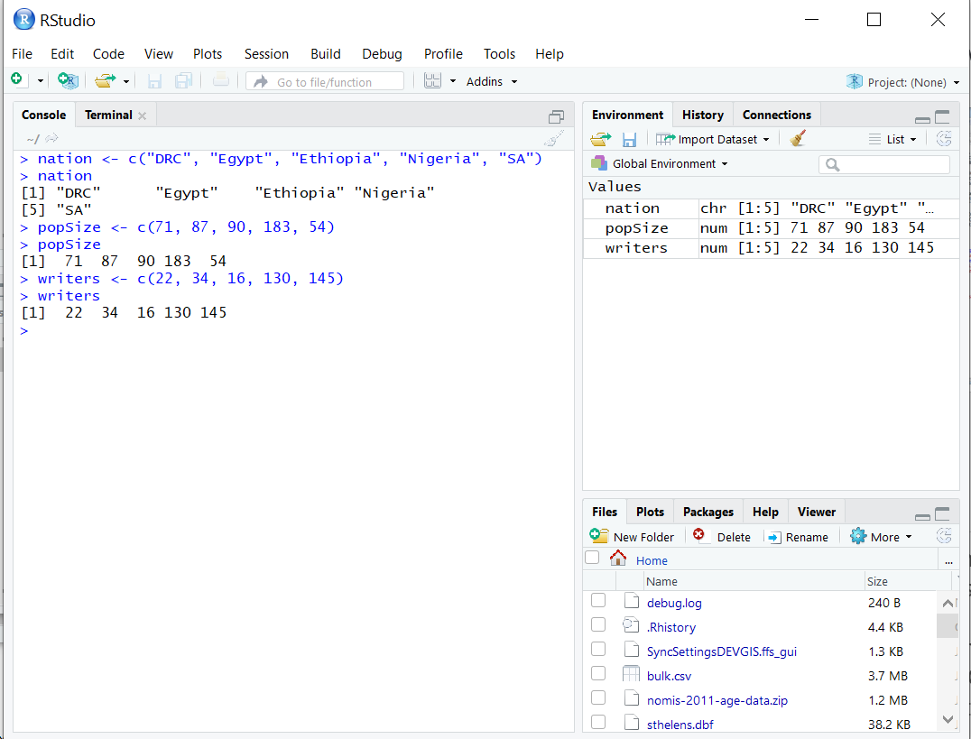
Using R
R is very different to Word, Excel …
Opening the R environment
GUI
RStudio

Slide 5
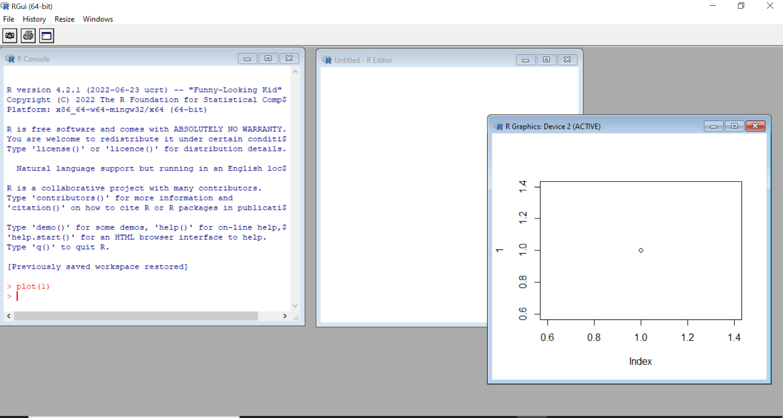
GUI Interface
Console
Script
Plot window

Slide 6
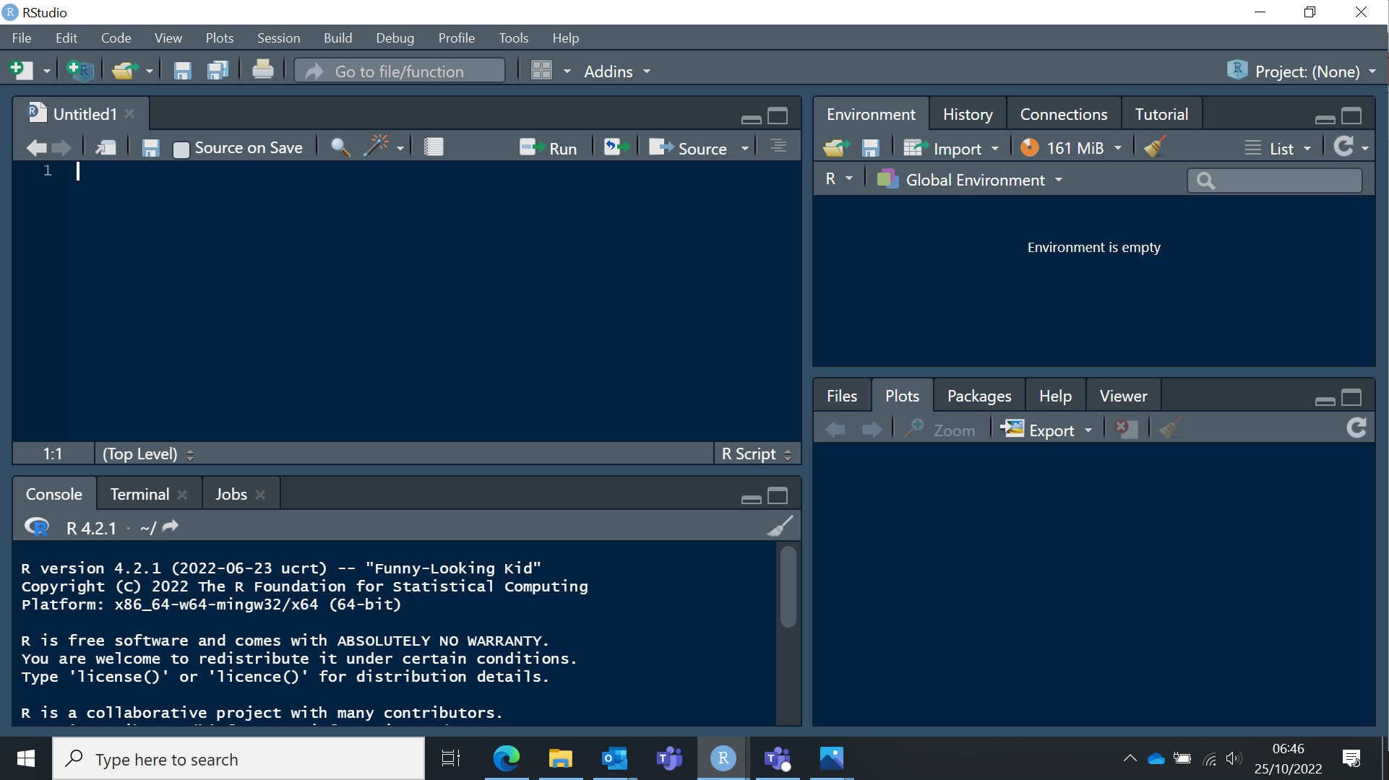
RStudio Interface
Script
Data attributes
Plot, files, packages, help
Console
Notes:
Four main fields:
Top left – Script section
Bottom left – R console; Terminal (for giving R additional commands); Jobs (shows running jobs)
Top right – Environment (saves objects created in R); History (shows all the commands you have run); etc
Bottom right – Files (shows files on your computer - can only open those compatible with R); Plots; Packages (shows packages installed in R); Help (when you ask for help, the result is displayed here); etc

Slide 7
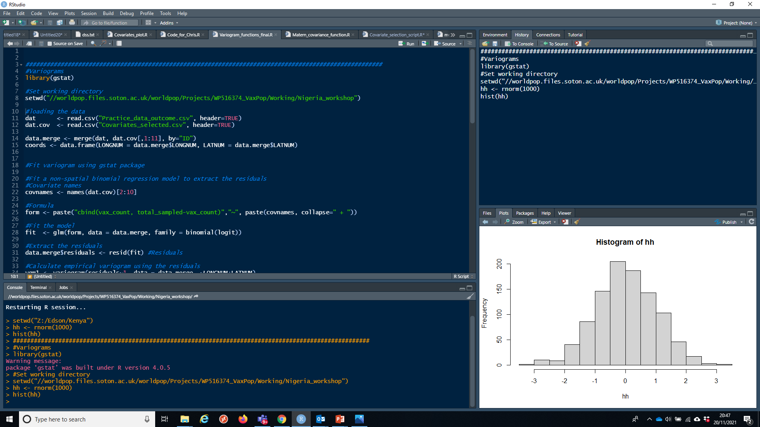
R Studio features

Slide 8
Using R - disadvantages
Steeper learning curve
Finding the right commands
Understanding error messages
Notes:
Learning R does have some disadvantages
A steeper learning curve than a GUI GIS
When I first learnt R I found finding the right commands the hardest, but there is a lot of help online for this
Also R’s error messages are often not that helpful.

Slide 9
Using R - advantages
Easy to record what you did and repeat specific pieces of work
Lots of reproducible examples on the web
Easily scriptable e.g. for using loops
For doing multiple graphs, plots or maps
Notes:
However there are many advantages to using R.
It uses scripts, and because of this it is very easy to record exactly what you did. With a GUI, there are many tools and options you could pick and it can be difficult to record exactly what you did and which parameters you used.
There are also lots of reproducible examples on the internet that you can see and reused.

Slide 10
Part 2: Creating Data in R
Creating Data in R
Data Handling

Slide 11
Data within R
R stores data as variables
Variables can be a number, a set of numbers, a name, a table, a set of spatial data, etc....

Slide 12
Data
R stores data as variables
nation <- c("DRC", "Egypt", "Ethiopia", "Nigeria", "SA")
popSize <- c(71, 87, 90, 183, 54)
writers <- c(22, 34, 16, 130, 145)

Slide 13
Data
popSize contains numbers
We can ask R what type of data any variable contains:
class(popSize)
R will return (answer) with:
“numeric”

Slide 14
Data
R can also do text
nation <- c("DRC", "Egypt", "Ethiopia", "Nigeria", "SA")
class(nation)
“character”
Notes:
And we can also ask what type of data this variable contains
Which is character (i.e. text).

Slide 15
Objects, functions and operators in R
Let's familiarise ourselves with 3 keys R components: objects, functions and operators
Objects are used to store values.
Functions allow us to perform manipulations on objects
Operators are used to create interactions between objects, or between an object and a function
Consider a set of numbers 1,2,3,4,5. We can concatenate this as a vector using the function c(),
then assign it to the object x through the assignment operator "<-"
x <- c(1, 2, 3, 4, 5)
x
[1] 1 2 3 4 5

Slide 16
Objects, functions and operators in R
Operators create interactions between objects. We can create a vector y and use the operator
"+" to sum x and y
Functions allow operations on objects
y <- c(2, 1, 2, 3, 1)
x + y
[1] 3 3 5 7 6
mean(x) # compute the mean of the vector x
[1] 3

Slide 17
Objects, functions and operators in R
Functions are always indicated with a name followed by '()'.
Anything inside the parentheses is an argument, or option that's passed.
Functions allow operations on objects
Some arguments are optional or have a 'default' value
sqrt(100) # 'sqrt' is the name of the square root function, and 100 is the argument
[1] 10
sqrt() # This results in an error (console message). 1 argument is required
test_object <- sqrt(144) # Store the return value of a function
test_object
[1] 12
round(2.71828) # omitting the second argument uses the default
[1] 3
round(2.71828, 2) # multiple arguments are separated by comma
[1] 2.72
round(2.71828, 4)
[1] 2.7183

Slide 18
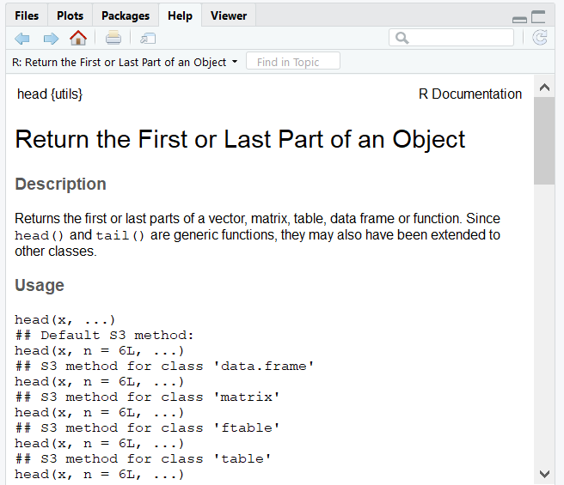
Objects, functions and operators in R
How will you know what arguments you have to supply?
1. Check the R manual (CRAN website manual)
2. Use R's Help:
?functionName - e.g. ?head
Help Tab
3. Stack Overflow (https://stackoverflow.com/ )
is a great website
People ask questions and post answers
There are over 300,000 questions on there
Odds are your question has been asked already

Slide 19

Exercise 1
Using the function 'rnorm', generate a set of 100 random numbers with mean 5 and standard deviation 3.
Generate another set of 1000 random numbers, using the mean and standard deviation of 0 and 1, respectively (standard normal).
Calculate the mean of the distributions generated in “a” and “b” above after trimming off 5% of the data.
random100 <- rnorm(n = 100, mean = 5, sd = 3)
random100 <- rnorm(n = 1000, mean = 0, sd = 1)
mean(random100, trim = 0.05)

Slide 20
Data Types
Objects that store values can be
a vector,
matrix,
list or
dataframe.
array,
Data frame is the most widely used data format, as it can combine different types of variables

Slide 21
Data Types: Vector
These variables (popSize and nation) are called vectors
All elements in a vector must be the same type
Vector has one dimension and has to be either numeric, character or factor
But can have as many elements as we like….
Within an object, we can use square brackets to select items by an 'index'.
nation[1] # get the first element of the vector nation
[1] "DRC"
nation[1:3] # get the first three items of the vector nation
[1] "DRC" "Egypt" "Ethiopia"

Slide 22
Data Types: Matrix
Matrix is two-dimensional data made up of rows and columns
m <- matrix(1:10, nrow=5, ncol=2)
m
[,1] [,2]
[1,] 1 6
[2,] 2 7
[3,] 3 8
[4,] 4 9
[5,] 5 10
m[4,]
[1] 4 9

Slide 23
Data: Matrix
Can combine multiple vectors into a matrix
cbind() – column bind, combine columns
Africa <- cbind(nation, popSize)
[ , ]
[rows, columns]
Notes:
R uses square brackets to represent rows and columns
Rows are always first, then columns.
Order is important!

Slide 24
Data: Matrix
[rows, columns]
popSize <- c(71, 87, 90, 183, 54)
nation <- c("DRC", "Egypt", "Ethiopia", "Nigeria", "SA")
How many rows and columns?

Slide 25
Data: Matrix
Can combine multiple vectors into a matrix
Africa <- cbind(nation, popSize)
5 rows
2 columns
nation | popSize
DRC | 71
Egypt | 87
Ethiopia | 90
Nigeria | 183
SA | 54

Slide 26
Dimensions
We can check the rows and columns
dim(Africa)
5 2

Slide 27
Data types: Data frame & List
Data Frame
A matrix has to contain items of the same type (number / string etc.)
A data frame can contain different types of elements
Country | Population | Writers
DRC | 71 | 22
Egypt | 87 | 34
Ethiopia | 90 | 16
Nigeria | 183 | 130
SA | 54 | 145
Notes:
Data frames are one of the most common data types – and we will be using them a lot.
Matrix and data frames are similar in R but not identical. We will usually be using data frames.

Slide 28
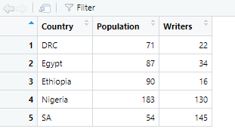
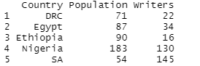
Data types: Data frame
dataframes can combine different variables.
#Dataframes
df <- data.frame(Country = c("DRC", "Egypt", "Ethiopia", "Nigeria", "SA"),
Population = c(71, 87, 90, 183, 54),
Writers = c(22, 34, 16, 130, 145))
Console view:
Scipt/Environment view:
#Dataframes
df$Country
[1] "DRC" "Egypt" "Ethiopia" "Nigeria" "SA"

Slide 29
Lists
Lists can contain elements of different types
Numeric / Characters
Vectors / Matrix / Data Frame
Even Lists!
out <- list(1,2,"three")
Notes:
Finally we have lists. Lists can contain elements of different types. We could have a list of numeric and character

Slide 30
Lists
out <- list(1,2,"three")
str(out)
List of 3
$ : num 1
$ : num 2
$ : chr "three"
Notes:
We can use str() to tell us what the list contains

Slide 31
Lists
We can also name each element
y <- list(person="Mike", gender="M", company="ProgramCreek")
Notes:
A list is like a vector, but one list can contain different types of elements. It’s a bit like a 1 dimensional data frame.
We can name element, e.g. ‘Mike’ element is named person

Slide 32
Exercise 2
Create a list that contain the table below. Then extract from this list the vector z
id | k | z
1 | P | P
2 | O | R
3 | P | O
4 | U | J
5 | L | E
6 | A | C
7 | T | T
8 | I | I
9 | O | O
10 | N | N
listing <- list(id = c(1, 2, 3, 4, 5, 6, 7, 8, 9, 10), k = c("P", "O", "P", "U", "L", "A", "T", "I", "O", "N"),
z = c("P", "R", "O", "J", "E", "C", "T", "I", "O", "N"))
listing$z

Slide 33
Logical and Boolean Operators
The dollar sign $ can be used to subset or add new variables to a dataframe
You can also subset the data using these operators:
> greater than
< less than
>= greater than or equal to
<= less than or equal to
== equal to
They return a logical vector (True/FALSE)
df$Area <- df$Population+10
df
df$Pop_density >10
FALSE FALSE FALSE FALSE FALSE

Slide 34
Logical and Boolean Operators
We can combine multiple logical tests with & (AND) as well as | (OR)
#Find out which countries have population density greater than 0.5 and more than 10 writers
df$Pop_density >0.5 & df$Writers>50
[1] FALSE FALSE FALSE TRUE TRUE
#Find out which countries have population density greater than 0.5 OR more than 10 writers
df$Pop_density >0.5 | df$Writers>50
TRUE TRUE TRUE TRUE TRUE

Slide 35
Part 3: Data Handling
Principles of R
Creating Data in R
Data Handling

Slide 36
Libraries
R uses libraries (or packages) to store different functions
R has many thousands (14,982) of packages
library = package
Packages are a collection of R functions, code, and sometimes data that enable us to work in R efficiently without writing complicated stuffs
Examples:
tidyverse: is a collection of R packages designed for data manipulations and visualizations.
sf: for working with spatial vector data.
STAN or INLA: Bayesian statistics

Slide 37
Installing & Loading Libraries
install.packages('tidyverse')
library(tidyverse)
install.packages("tmap")
library(tmap)
install.packages(“leaflet")
library(leaflet)
install.packages("sf")
library(sf)
install.packages(“raster")
library(raster)
https://github.com/ortisyankey/Nigeria_Workshop

Slide 38
Working directory
R uses a ‘working directory’ to store your files in
You might have a different one for each project / piece of work
setwd("C:/Users/oy1r22/OneDrive - University of Southampton/Desktop/Day 1/Script and Data")
Alternatively if our dataset is located in different directories or subfolders we can create different path to access the data
#Specify Drive Path
drive_path <- "C:/Users/oy1r22/OneDrive - University of Southampton/Desktop/Day 1/"
input_path <- paste0(drive_path, "Script and Data/")

Slide 39
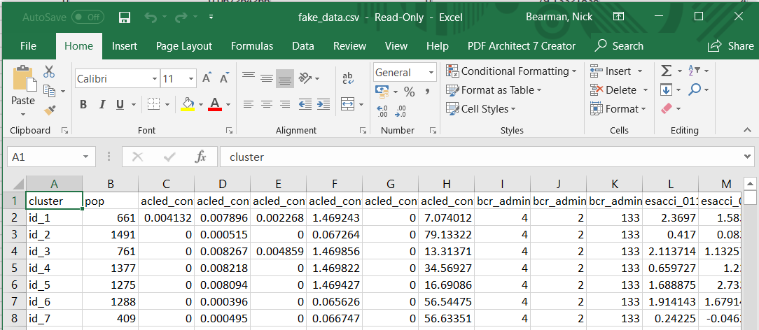
Loading data
We’ve already put some data into R
popSize <- c(71, 87, 90, 183, 54)
But mostly data is much larger:
Notes:
We will often get data as a CSV file, but sometimes in many other formats as well

Slide 40
Loading data
We can use read.csv() to load a csv file
fake_data <- read.csv(“fake_data.csv”)
And we can then use class(), dim() and str() in exactly the same way as before
class()
View ( )
dim()
str()
#View data
View(fake_data)
#structure of variables
str(fake_data)
#dimension
dim(fake_data)

Slide 41
Preview data
dim(fake_data)
[1] 920 8
What does this mean?

Slide 42
Preview data
With a much larger dataset, we can’t just type the name of data and get the whole dimension it would be pages and pages!
We can use head()
head(fake_data)
Which shows us the first 6 rows

Slide 43
Preview data
We also have tail() which shows us the last 6 rows.
We can’t check every single row because we have too many. We can:
dim() to check the number of rows / columns
head() and tail() to check some rows of data

Slide 44
Preview data
We can also use nrow and ncol to count the number of rows and columns (like dim()).
length() is another way of counting.
colnames() will tell us what all of the columns are called – very useful for a large dataset

Slide 45
Help
There are a few ways of finding help in RStudio:
?functionName - e.g. ?head
Help Tab
Sometimes these are useful, sometimes they are not

Slide 46
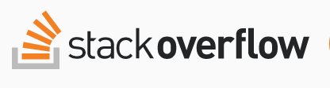
Help
Stack Overflow is a great website
People ask questions and post answers
There are over 300,000 questions on there
Odds are your question has been asked already

Slide 47

Help
ChatGPT is the latest AI
Works just like google
Anything you want to do, you can ask ChatGPT for answers

Slide 48
Summary
Principles of R
Creating Data in R
Data Handling

Slide 49
Acknowledgement

Slide 50
Data Manipulation & Visualizations
Dr. Ortis Yankey,
Research Fellow, WorldPop
Feb 2023

Slide 51
Part 2: Data Manipulation and Visualization
Contents
Basic Data Manipulation
Advanced data manipulation with tidyverse
Data visualization
Using ggplot for data visualization

Slide 52
Sub-setting / Slicing a variable
Sometimes we need to select out a specific part of a variable
We can use [ ] for this
It’s called sub-setting or slicing
data.vector[index]
#Sub-Setting/Slicing a variable
#We want to subset states with a population of less 2million people
Nigeria_Pop[Nigeria_Pop$total < 2000000, ]
FID statecode statename capcity id region total q025 q05 q25 q50 q75 q95 q975 precipitation_mean
6 5 BY Bayelsa Yenagoa 159 5 1099952 913600.2 937998 1021962 1089311 1165762 1300838 1356331 1480.652
temperature_mean elevation slope
6 25.64804 310.2857 0.4285714

Slide 53
Sub-setting / Slicing a variable
We can also use : to represent a range
Which can also be use to slice through data
#Slice data by index. We want to select the first 10 rows of our population data
Nigeria_Pop[1:10, ]
FID statecode statename capcity id region total q025 q05 q25 q50 q75 q95 q975
1 0 PL Plateau Jos 180 2 3639275 2238255.5 2410572 2962401 3444654 4085814 5513280 6174099
2 1 AK Akwa Ibom Uyo 181 1 3485613 3033511.9 3104335 3310985 3467975 3642350 3925477 4024870
3 2 TA Taraba Jalingo 192 2 4228507 1984272.3 2229877 3151859 3863693 4874087 7290584 8512098
4 3 KD Kaduna Kaduna 194 9 8620189 7410068.9 7586108 8124712 8567865 9038946 9877225 10197561
5 4 OG Ogun Abeokuta 218 11 9506520 6495977.1 6885790 8173522 9177297 10474327 13068066 14271819
6 5 BY Bayelsa Yenagoa 159 5 1099952 913600.2 937998 1021962 1089311 1165762 1300838 1356331
7 6 AD Adamawa Yola 226 2 3606704 3170179.5 3228696 3434705 3587957 3756568 4034200 4146925
8 7 CR Cross River Calabar 229 6 2969531 1351366.6 1517248 2156958 2744471 3468072 5142649 6030866
9 8 OS Osun Oshogbo 255 7 4747219 3409215.9 3595666 4195569 4644190 5174428 6208891 6711189
10 9 EK Ekiti Ado 160 7 2073712 1274603.3 1399050 1773326 2002807 2269961 2979712 3362753

Slide 54
Summarizing data
We can summarize the data using the summary ( ):
#Summary statistics of data
summary(Nigeria_Pop)
FID statecode statename capcity id region total
Min. : 0 Length:37 Length:37 Length:37 Min. :159.0 Min. : 1.000 Min. : 1099952
1st Qu.: 9 Class :character Class :character Class :character 1st Qu.:173.0 1st Qu.: 2.000 1st Qu.: 3457181
Median :18 Mode :character Mode :character Mode :character Median :199.0 Median : 5.000 Median : 4083570
Mean :18 Mean :204.6 Mean : 5.486 Mean : 4874628
3rd Qu.:27 3rd Qu.:240.0 3rd Qu.: 9.000 3rd Qu.: 5625974
Max. :36 Max. :256.0 Max. :11.000 Max. :13724246
q025 q05 q25 q50 q75 q95 q975
Min. : 913600 Min. : 937998 Min. : 1021962 Min. : 1089310 Min. : 1165762 Min. : 1300838 Min. : 1356331
1st Qu.: 2238255 1st Qu.: 2410572 1st Qu.: 3035243 1st Qu.: 3432599 1st Qu.: 3639419 1st Qu.: 4491149 1st Qu.: 4842767
Median : 2947545 Median : 3104335 Median : 3440110 Median : 3898228 Median : 4504456 Median : 5984245 Median : 6711189
Mean : 3363594 Mean : 3564468 Mean : 4223006 Mean : 4710728 Mean : 5317267 Mean : 6702662 Mean : 7382334
3rd Qu.: 3409216 3rd Qu.: 3623950 3rd Qu.: 4544796 3rd Qu.: 5224774 3rd Qu.: 6369710 3rd Qu.: 7849747 3rd Qu.: 8741895
Max. :11827721 Max. :12084618 Max. :12952364 Max. :13630740 Max. :14385145 Max. :15666944 Max. :16128442

Slide 55
Summarising data
We can also do more summary statistics:
mean()
median()
quantile()
min()
max()
> mean(Nigeria_Pop$total)
[1] 4874628
> median(Nigeria_Pop$total)
[1] 4083570
> quantile(Nigeria_Pop$total)
0% 25% 50% 75% 100%
1099952 3457181 4083570 5625974 13724246
> min(Nigeria_Pop$total)
[1] 1099952
> max(Nigeria_Pop$total)
[1] 13724246

Slide 56
Creating another variable
We can create another variable in our dataframe using the $ sign
#Let create another column called monthly_temperature = temperature_mean/12
Nigeria_Pop$monthly_temperature <- Nigeria_Pop$temperature_mean/12
View(Nigeria_Pop)

Slide 57
Dealing with NA values
NA is an important concept in R
Particularly for missing values
You will come across missing data
R doesn't always work well with missing data
In some datasets, NA is used to represent missing data
##To overide NA we use the function na.rm = T
#Dealing with NA Values
sum(Nigeria_Pop$gdp)
[1] NA
sum(Nigeria_Pop$gdp, na.rm = T)
[1] 1107601

Slide 58
Advance data manipulation using Tidyverse
The "tidyverse" is a collection of R packages designed for data science and visualization. It includes the following packages:
ggplot2: A popular package for creating graphics and visualizations.
dplyr: A package for data manipulation and cleaning.
tidyr: A package for reshaping and cleaning data.
readr: A package for reading and writing delimited files.
purrr: A package for functional programming in R.
tibble: A modern reimplementation of data frames.
stringr: A package for working with strings.
lubridate: A package for working with dates and times.
forcats: A package for working with categorical variables.

Slide 59
Advance data manipulation using Tidyverse
We are going to apply a few of the functions in the dplyr package
filter(): Select rows based on certain conditions.
select(): Choose specific columns to work with.
group_by(): Group the rows of a data frame by one or more variables.
summarize(): Compute summary statistics for each group created by group_by().
mutate(): Add new columns to a data frame based on existing columns.
rename(): Change the names of columns in a data frame.

Slide 60
Filtering and Selecting observations
#subset rows based on certain condition.
#We are subsetting observations with a population of more than 10 million people
Nigeria_Pop %>%
filter(total >= 10000000)
FID statecode statename capcity id region total precipitation_mean temperature_mean elevation slope gdp buildings
1 21 KN Kano Kano 175 9 13724246 1459.559 25.97464 294.6667 0.6666667 NA 16128442
Pop_density
1 0.8509344
#Select certain variables
#we are selecting the variable state and total
Nigeria_Pop %>%
select(statename, total)
statename total
1 Plateau 3639275
2 Akwa Ibom 3485613
3 Taraba 4228507
4 Kaduna 8620189
5 Ogun 9506520
6 Bayelsa 1099952
7 Adamawa 3606704
8 Cross River 2969531
9 Osun 4747219
10 Ekiti 2073712

Slide 61
Grouping and Summarizing observations
#We will group the observations by region and summarise their population per region
Nigeria_Pop %>%
group_by(region) %>%
summarise(regional_population = sum(total))
# A tibble: 11 × 2
region regional_population
<int> <dbl>
1 1 14720725.
2 2 25419443.
3 3 19216928.
4 4 8985671.
5 5 6389860.
6 6 5741063.
7 7 17837401.
8 8 7664782.
9 9 42726762.
10 10 12632237.
11 11 19026365.

Slide 62
Mutating & Renaming Observations
#We want to add another variable called density = total/buildings
Nigeria_Pop <- Nigeria_Pop %>%
mutate(density = total/buildings)
#We want to rename density to population_density
Nigeria_Pop<- Nigeria_Pop %>%
rename(Pop_density = density)
#if you want to save the data as a new csv document, you can use the write.csv function
write.csv(Nigeria_Pop, paste0(input_path, 'New Nigeria Population.csv'))

Slide 63
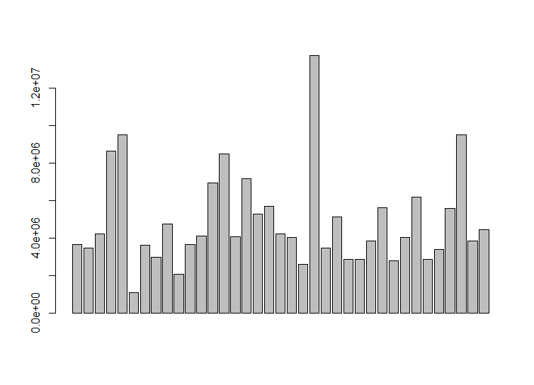
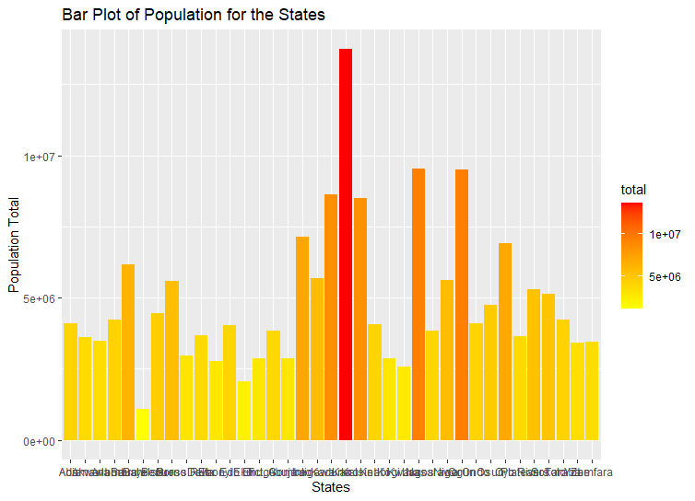
Data Visualizations
Data visualisation is important as it forms part of the exploratory data analyses
A barplot can be useful for discrete data
barplot(Nigeria_Pop$total)
#We can also use ggplot to make nice plots
ggplot(Nigeria_Pop, aes(x = statename, y = total, fill = total)) +
geom_bar(stat = "identity") +
scale_fill_gradient(low = "yellow", high = "red") +
labs(x = "States", y = "Population Total", fill = "total") +
ggtitle("Bar Plot of Population for the States")

Slide 64
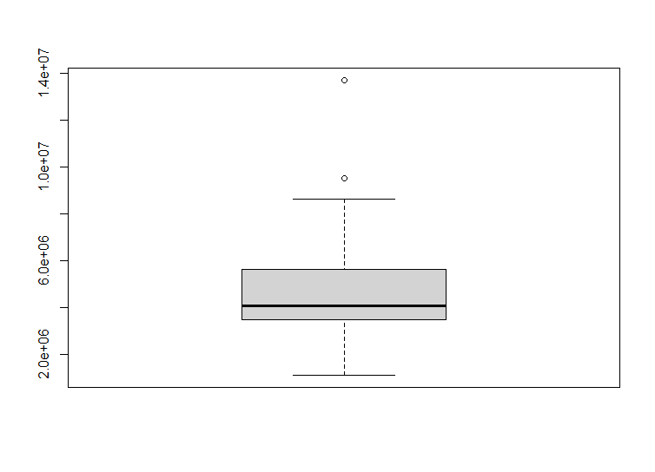
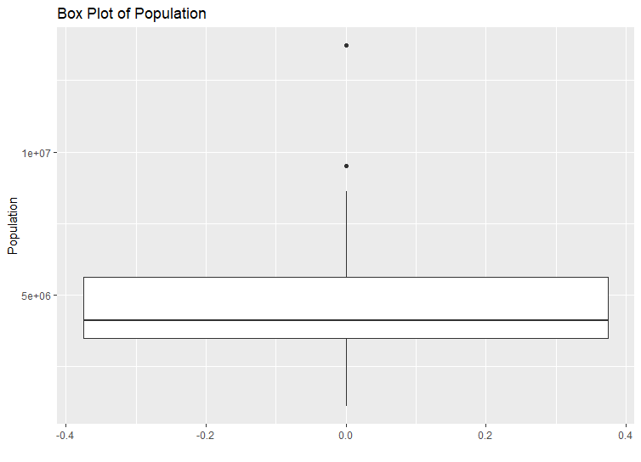
Data Visualizations
A boxplot is the simplest for continuous data
boxplot(Nigeria_Pop$total)
# plot the boxplot using ggplot
ggplot(Nigeria_Pop, aes(y = total)) +
geom_boxplot() +
labs(x = " ", y = "Population") +
ggtitle("Box Plot of Population")

Slide 65
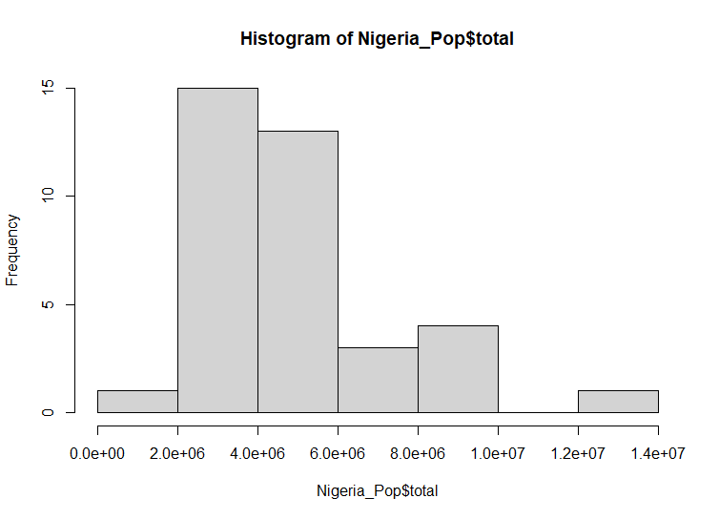
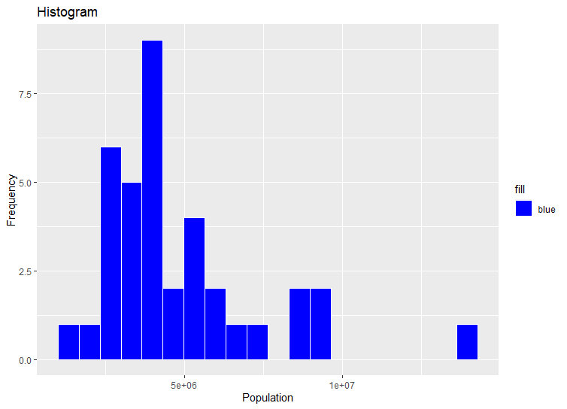
Data Visualizations
Histogram is also another alternative that shows the frequency distribution of a variable
hist(Nigeria_Pop$total)
# plot the histogram using ggplot
ggplot(Nigeria_Pop, aes(x = total, fill = "blue")) +
geom_histogram(bins = 20, color = "white") +
scale_fill_manual(values = "blue") +
labs(x = "Population", y = "Frequency") +
ggtitle("Histogram")

Slide 66
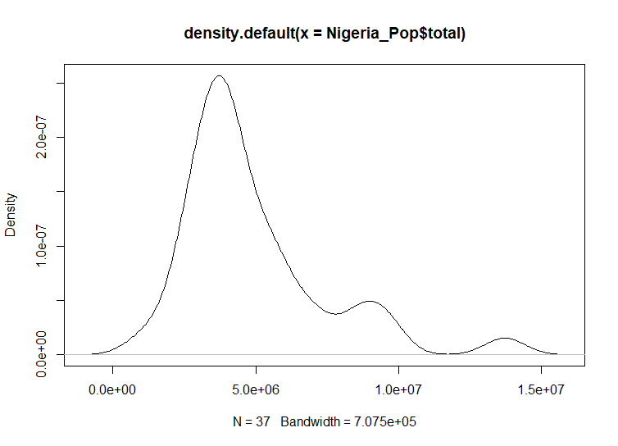
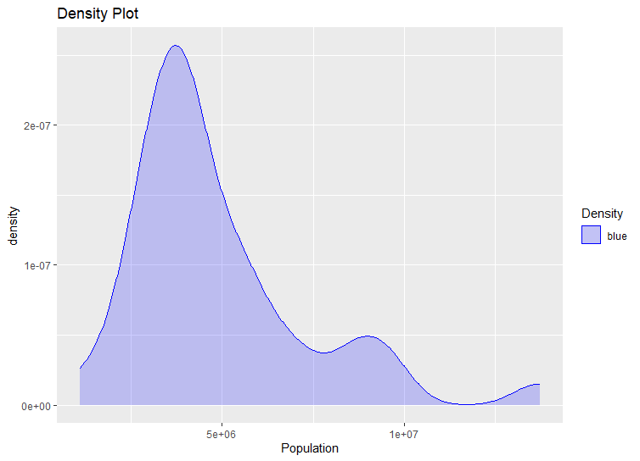
Data Visualizations
Density plots are a smoothed histograms
plot(density(Nigeria_Pop$total))
# plot the density plot using ggplot
ggplot(Nigeria_Pop, aes(x = total, color = "blue")) +
geom_density(fill = "blue", alpha = 0.2) +
scale_color_manual(values = "blue") +
labs(x = "Population", color = "Density") +
ggtitle("Density Plot")

Slide 67
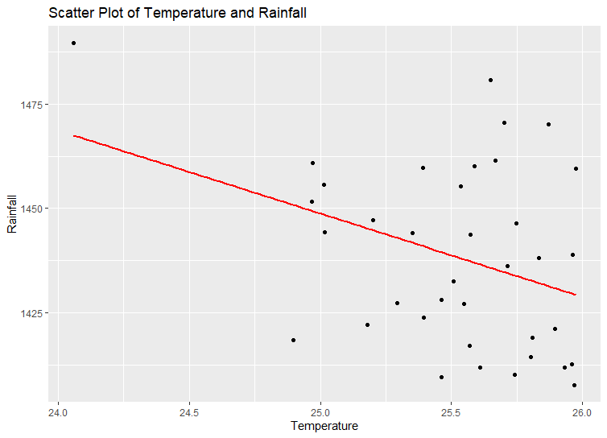
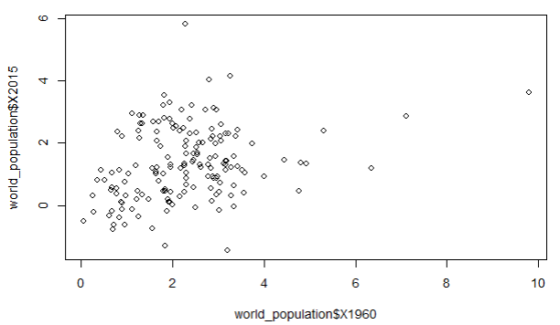
Data Visualizations
We can also create a variety of scatter plots, when we want to show multivariate data
#Scatter plot of temperature and rainfall
plot(Nigeria_Pop$precipitation_mean, Nigeria_Pop$temperature_mean)
# plot the scatter plot and fit a line using ggplot
ggplot(Nigeria_Pop, aes(x = temperature_mean, y = precipitation_mean)) +
geom_point() +
geom_smooth(method = "lm", se = FALSE, color = "red") +
labs(x = "Temperature", y = "Rainfall") +
ggtitle("Scatter Plot of Temperature and Rainfall")

Slide 68
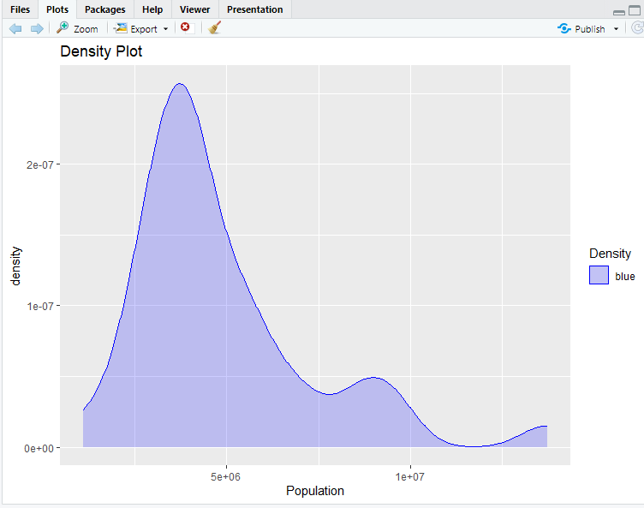
Data Visualizations
Showing plots
You can show the previous and
next plots using the arrows

Slide 69
Data Visualizations
Saving plots
We can save plots from the
Export option in the plots window

Slide 70
Exercise
Load the fake data
Check the data structure of the fake data
Subset the observations with a population of more than 1000 people
Plot a histogram of the pop variable

Slide 71




@
End!
@WorldPopProject
www.worldpop.org
o.yankey@soton.ac.uk
+447464277799
@YankeyOrtis
11

